Slide 1
Neural Network Algorithm
Presented by,
Sujash Bhattacharya

Slide 2
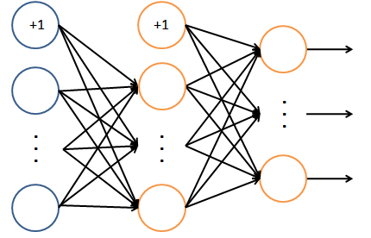

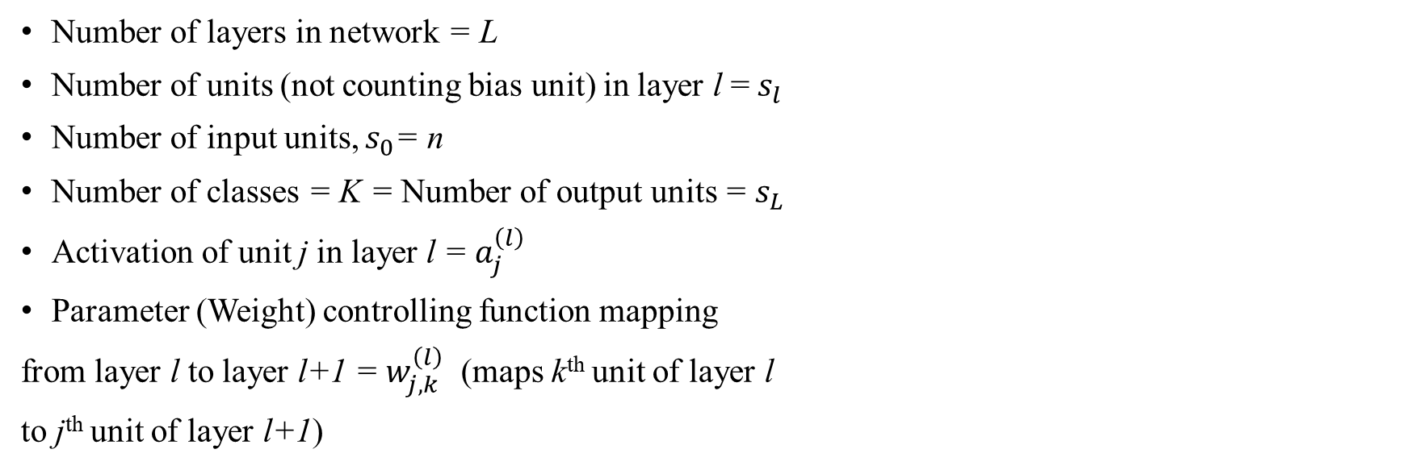

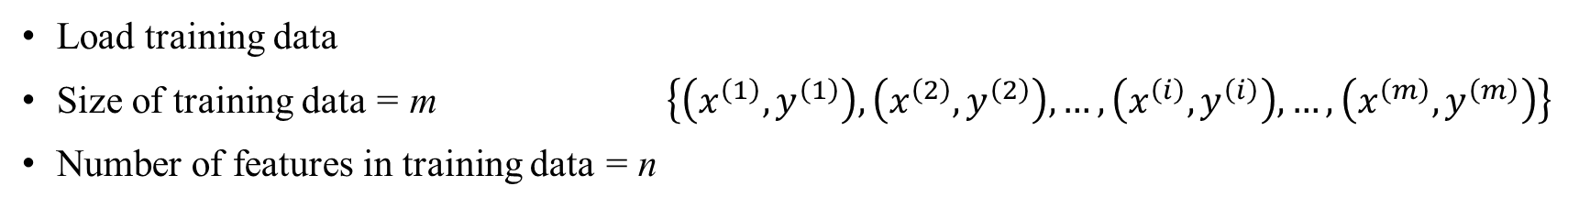




Loading data
Load training data
Size of training data = m $\left\{\left(x^{\left(1\right)},y^{\left(1\right)}\right),\left(x^{\left(2\right)},y^{\left(2\right)}\right),…,\left(x^{\left(i\right)},y^{\left(i\right)}\right),…,\left(x^{\left(m\right)},y^{\left(m\right)}\right)\right\}$
Number of features in training data = n
Network architecture
Number of layers in network = L
Number of units (not counting bias unit) in layer l = $s_{l}$
Number of input units, $s_{0}$= n
Number of classes = K = Number of output units = $s_{L}$
Activation of unit j in layer l = $a_{j}^{\left(l\right)}$
Parameter (Weight) controlling function mapping
from layer l to layer l+1 = $w_{j,k}^{\left(l\right)}$ (maps k^{th} unit of layer l
to j^{th} unit of layer l+1)
$$W^{\left(0\right)}$$
$$W^{\left(1\right)}$$
$$w_{j,k}^{\left(l\right)}$$
$${x_{j}=a}_{j}^{\left(0\right)}$$
$$a_{j}^{\left(1\right)}$$
$$a_{j}^{\left(2\right)}=h_{w}\left(x\right)$$

Slide 3
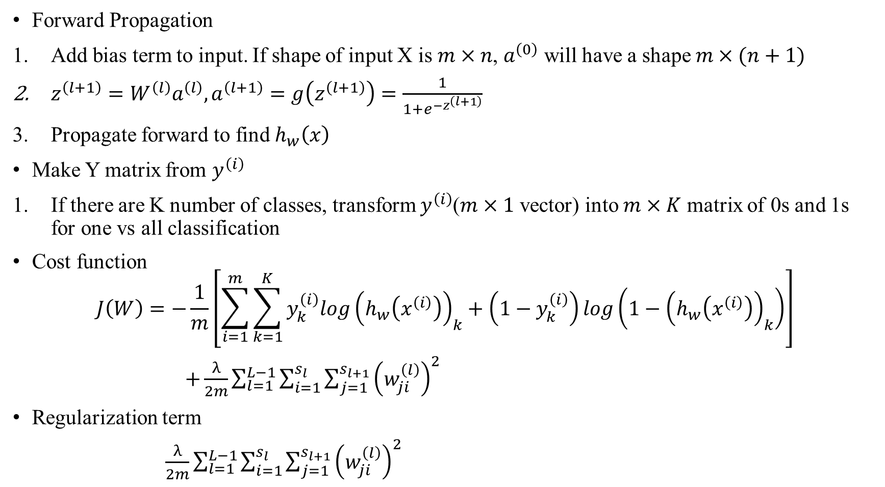
Cost function
Forward Propagation
Add bias term to input. If shape of input X is $m×n$, $a^{\left(0\right)}$ will have a shape $m×(n+1)$
$z^{\left(l+1\right)}=W^{\left(l\right)}a^{\left(l\right)},a^{\left(l+1\right)}=g\left(z^{\left(l+1\right)}\right)=\frac{1}{1+e^{−z^{\left(l+1\right)}}}$
Propagate forward to find $h_{w}\left(x\right)$
Make Y matrix from $y^{\left(i\right)}$
If there are K number of classes, transform $y^{\left(i\right)}$($m×1$ vector) into $m×K$ matrix of 0s and 1s for one vs all classification
Cost function
$$J\left(W\right)=−\frac{1}{m}\left[\sum_{i=1}^{m}{\sum_{k=1}^{K}{y_{k}^{\left(i\right)}log{\left(h_{w}\left(x^{\left(i\right)}\right)\right)}_{k}+\left({1−y}_{k}^{\left(i\right)}\right)log\left({1−\left(h_{w}\left(x^{\left(i\right)}\right)\right)}_{k}\right)}}\right]$$
$+\frac{λ}{2m}\sum_{l=1}^{L−1}{\sum_{i=1}^{s_{l}}{\sum_{j=1}^{s_{l+1}}{{\left(w_{ji}^{\left(l\right)}\right)}^{2}}}}$
Regularization term
$\frac{λ}{2m}\sum_{l=1}^{L−1}{\sum_{i=1}^{s_{l}}{\sum_{j=1}^{s_{l+1}}{{\left(w_{ji}^{\left(l\right)}\right)}^{2}}}}$

Slide 4
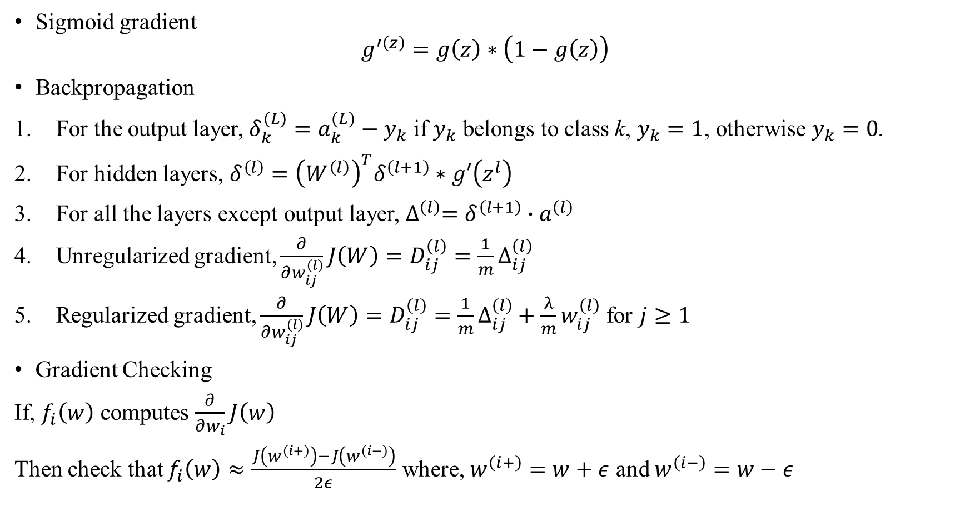
Cost function Gradient
Sigmoid gradient
$$g^{′\left(z\right)}=g\left(z\right)∗\left(1−g\left(z\right)\right)$$
Backpropagation
For the output layer, $δ_{k}^{\left(L\right)}=a_{k}^{\left(L\right)}−y_{k}$ if $y_{k}$ belongs to class k, $y_{k}=1$, otherwise $y_{k}=0$.
For hidden layers, $δ^{\left(l\right)}={\left(W^{\left(l\right)}\right)}^{T}δ^{\left(l+1\right)}∗g′\left(z^{l}\right)$
For all the layers except output layer, $∆^{\left(l\right)}=δ^{\left(l+1\right)}∙a^{\left(l\right)}$
Unregularized gradient, $\frac{∂}{∂w_{ij}^{\left(l\right)}}J\left(W\right)=D_{ij}^{\left(l\right)}=\frac{1}{m}∆_{ij}^{\left(l\right)}$
Regularized gradient, $\frac{∂}{∂w_{ij}^{\left(l\right)}}J\left(W\right)=D_{ij}^{\left(l\right)}=\frac{1}{m}∆_{ij}^{\left(l\right)}+\frac{λ}{m}w_{ij}^{\left(l\right)}$ for $j≥1$
Gradient Checking
If, $f_{i}\left(w\right)$ computes $\frac{∂}{∂w_{i}}J\left(w\right)$
Then check that $f_{i}\left(w\right)≈\frac{J\left(w^{\left(i+\right)}\right)−J\left(w^{\left(i−\right)}\right)}{2ε}$ where, $w^{\left(i+\right)}=w+ε$ and $w^{\left(i−\right)}=w−ε$

Slide 5
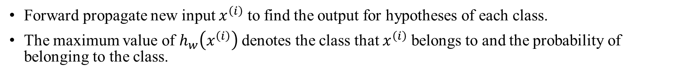
Random initialization of weights
Initialize each $w_{j,k}^{\left(l\right)}$to a random value in $\left[−ε,ε\right]$ (i.e. $−ε≤w_{j,k}^{\left(l\right)}≤ε$)
$W^{(l)}=rand\left(s_{l+1},s_{l}+1\right)∗\left(2∗ε\right)−ε$
Learning parameters by optimize
Write cost function as a function of only weights and biases.
Optimize minimize the cost function with randomly initialized parameters.
Predict
Forward propagate new input $x^{\left(i\right)}$ to find the output for hypotheses of each class.
The maximum value of $h_{w}\left(x^{\left(i\right)}\right)$ denotes the class that $x^{\left(i\right)}$ belongs to and the probability of belonging to the class.

